Slide 1

HOLISTIC COLLEGE ADMISSIONS

Slide 2

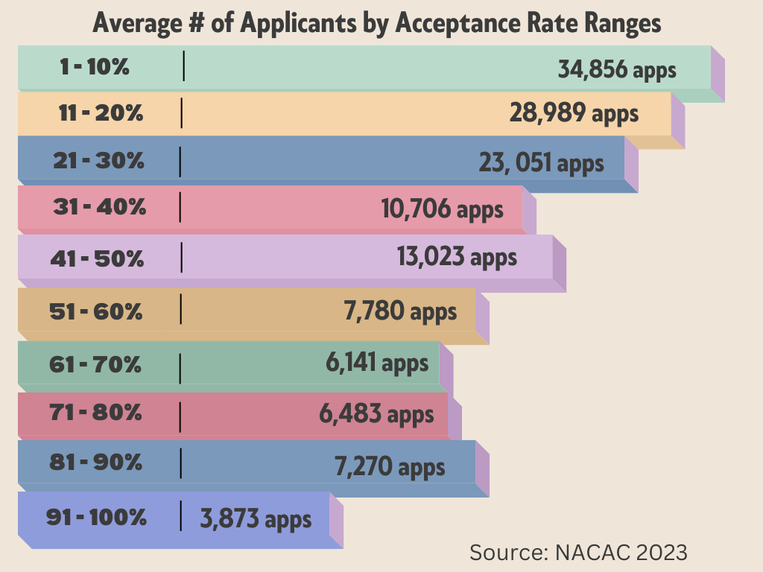
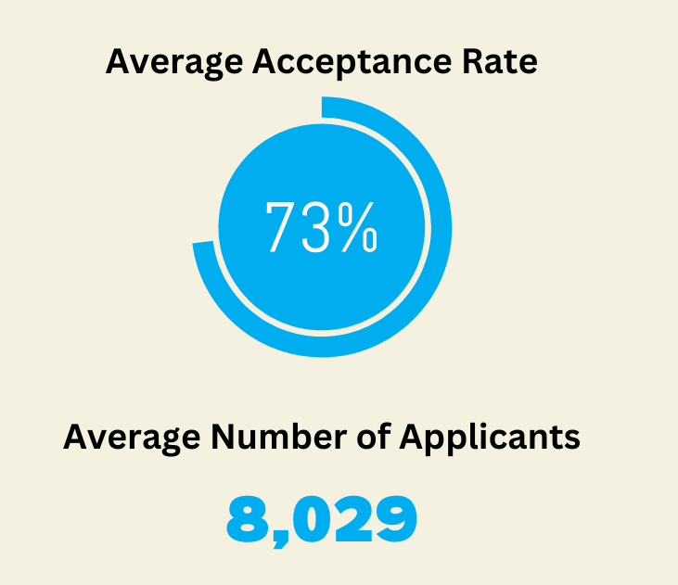

Selectivity Spectrum
There are over 4,000 four-year colleges in the US.
While the “top” 100 schools have low acceptance, the majority of colleges take most of their applicants.

Slide 3

The Power of a Cohesive College Application
No part of a college application—not the resume, the transcript, recommendations, the personal statement, nor the supplemental essays—exists in a vacuum.
Everything in the applicant’s file, down to email correspondences with the admissions office, is taken together.

Slide 4


Admissions officers are trained to look for coexistence and synergy to tie elements together into a coherent and nuanced picture of who you, the applicant, are.
It all works together, telling a common, cohesive story. The result? You transform from just another sheet of paper into a real human being.
For an admissions officer who only has 7.5 minutes to review your file, it helps them easily tell your story to an admissions committee to advocate for you.

Slide 5




Three Main Categories of Evaluation
What
Why
and Where
Character
and
Contribution
Academic

Slide 6


Holistic Admission Criteria
Academic
Strong GPA
Strength of curriculum
ACT or SAT score

Slide 7
Pathways toward fulfilling Academic Criteria
The more selective the school, the more these will be considered
Honors and AP in areas of interest/strength
Ideally A’s with some B’s Less selective schools will accept lower grades Consistency or Improvement with grades
Intentionality with core subjects (ie. if you’re strength is STEM, taking strong math and science throughout HS)
Consistency and Intentionality with Electives (ie. taking Debate all the way through HS; taking Business classes if pursuing a Business major)

Slide 8

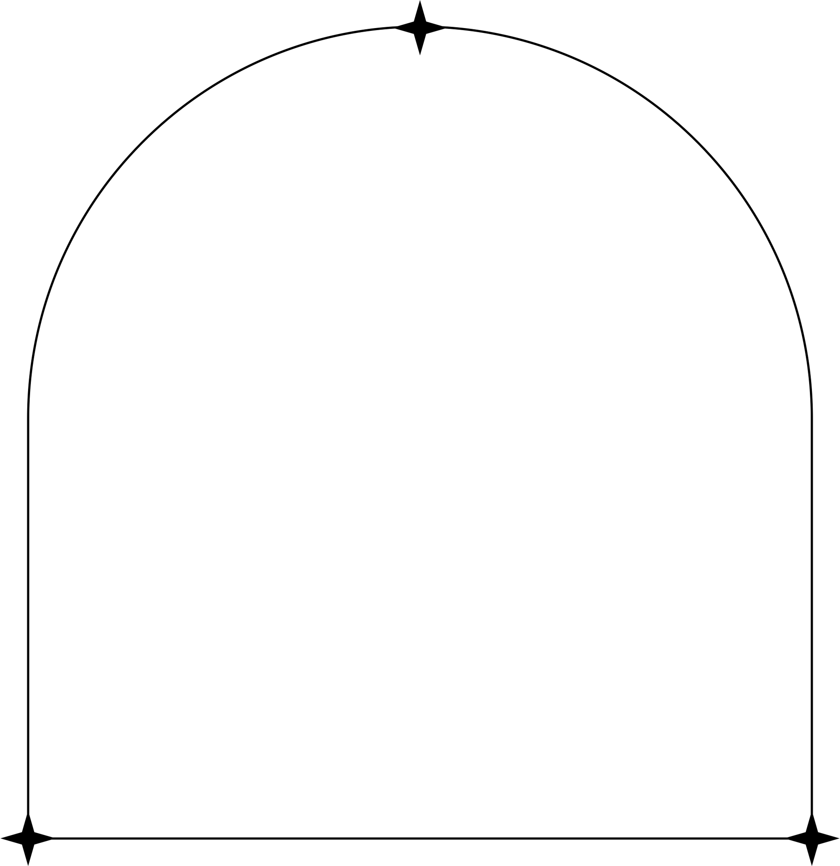
Holistic Admission Criteria
Character and Contribution
Extracurricular Activities
Essays
Letters of Recommendation
Character and Contribution

Slide 9
Pathways toward fulfilling Character and Contribution
Through ECs and essays, demonstrate traits such as the following: Grit/Drive/Determination | Intellectual Curiosity | Initiative/Self-Advocacy Leadership/Collaboration | Empathy/Social Consciousness | Enthusiasm/Positivity Contribution | Diversity of Experience
ECs should demonstrate areas of interest/passion through opportunities taken or created.
Personal statement will provide information not found elsewhere on the application and should highlight character traits.
Letters of recommendation should corroborate the character traits demonstrated through the application.

Slide 10
Holistic Admission Criteria
What You Want to Study, Why and Where
Why are you going to college? What is your intended college major and career plan?
“Why Us” and “Why Major” Supplementals
Other forms of demonstrating interest

Slide 11
Pathways toward fulfilling What, Why and Where
Begin early to identify strengths and interests and how they tie to careers. Consider what your educational path should be to pursue that career. This can be specific or general. Tie in your academics and extracurricular activities.
Through supplemental essays, make a strong case why you want to attend and why their school has the major you want. This will be accomplished through in-depth research prior to writing the essay.
A large percentage of of students change their major and almost all adults change their career one or more times in their lives. No one will hold you to the plan you make in high school. But colleges do like to see some consideration of this in the application.
Some schools track demonstrated interest to include attending presentations, getting on email list and clicking on emails, responding to inquiries from the school.

Slide 12



Well-Rounded -> Specialist -> Interdisciplinary
Old Approach
Be involved in everything. Pack your schedule with as many activities as you can in a variety of areas. Spread yourself thin.
New Approach
Identify interests and passions early and take advantage of opportunities to explore them or create own opportunities.
Spend time with true interests, not to check a box for the sake of college applications.
Trending Approach
Combine two different areas of interest to create unique educational path.
EX: Neuroscience and Art - Exploring how visual art therapy impacts brain function and mental health.
History and Data Science - Analyzing historical trends through data visualization and statistical analysis.

Slide 13

It is important to remember that each college has it’s own institutional priorities that drive their recruitment, and certain characteristics they seek in applicants that help shape a diverse class or fill a need.
These are out of our control, so we control what we can and know that there are many schools that will provide an excellent college experience.

Slide 14
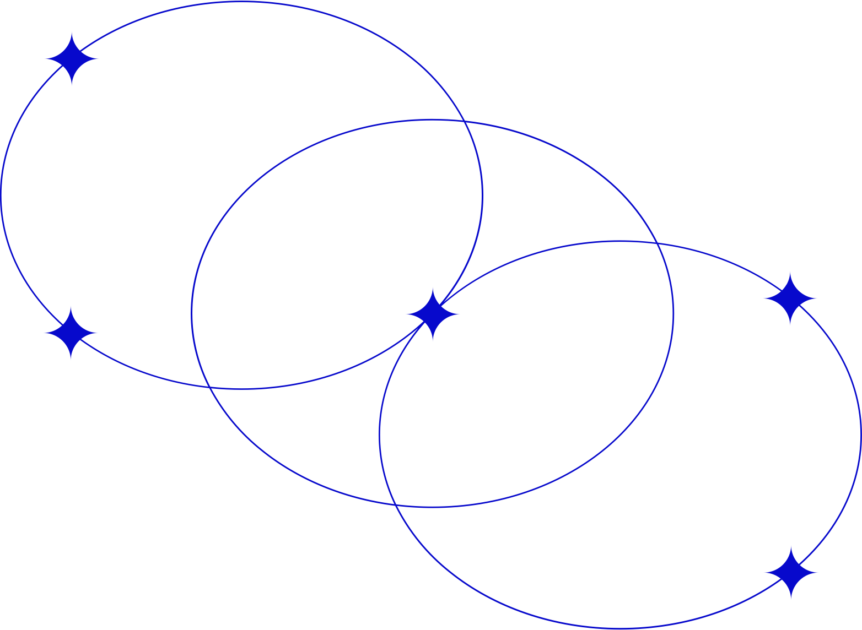


www.vpcollegeconsulting.com

